Slide 1
IBM AICTE PROJECT
Tracking Maternal Health Progress
Toward SDG 3.1
CAPSTONE PROJECT
Presented By:
Pratiksha Mahajan

Slide 2
OUTLINE
Problem Statement
Proposed Solution
System Development Approach (Technology Used)
End Users
Algorithm & Deployment
Result (Output Image)
Conclusion
Github Link
Future Scope
References

Slide 3
Problem Statement
Sustainable Development Goal 3.1 aims to reduce the global and India’s maternal mortality ratio (MMR) to less than 70 per 100,000 live births by 2030. However, disparities in access to antenatal care, adolescent pregnancies, and lack of skilled birth attendants still result in high maternal deaths, particularly in low-income regions. There is a need to track these indicators using data to generate insights and prioritize action.

Slide 4
Proposed Solution
The proposed system uses AI-driven analysis of key
health indicators such as:
Maternal Mortality Rate
Antenatal care coverage
Adolescent birth rate
Skilled birth attendance
Healthcare expenditure
Institutional births (in the 5 years before the survey) (%)
It provides:
Data visualizations (trends, maps, comparisons)
Regression-based MMR prediction
Insight into which factors most influence maternal health
Actionable recommendations for policy improvements

Slide 5
System Development Approach
IBM Cloud Lite Tools and Models Used:
IBM cloud lite services
IBM Cloud Watsonx AI Studio- Data analysis + modeling
IBM Cloud Watsonx AI runtime
Cloud Object Storage – Dataset hosting
Jupiter Notebook – Python-based analysis
Watson Machine Learning model
Linear Regression
Random Forest Regressor
Libraries Required:
Pandas, NumPy, Seaborn, Matplotlib, Scikit-learn

Slide 6
End Users
Government Health Departments
Policy Makers & Planners
Healthcare NGOs & Foundations
Researchers and Public Health Analysts
Rural Health Workers & ASHAs
Mobile Health App Developers

Slide 7
Algorithm & Deployment
Algorithm Selection:
Linear Regression was chosen due to the continuous numerical
nature of MMR and associated indicators.
Data Input:
Adolescent Birth Rate
Antenatal Care (%)
Skilled Birth Attendance (%)
Maternal Mortality Rate (per 1lakh live births)
Institutional births (in the 5 years before the survey) (%)
Training Process:
Data was split into training and testing sets (80:20 ratio)Model trained using scikit-learn
The Random Forest model was trained using the training set.
Model performance was evaluated using:
R² Score
Mean Squared Error (MSE)
Prediction Process:
Model predicts MMR from health indicators
The model was deployed using IBM Watson Machine Learning (WML)

Slide 8
Result (Output Image)
Strongest predictors: Antenatal care and skilled birth attendance.
States with lower ANC/skilled attendance showed higher MMR.
watsonx ML model explained majority of the variance in MMR (R^2 Score: 0.1757).
Time trend shows MMR decline in states with higher antenatal care
Correlation heatmap reveals strongest link between adolescent birth rate and high MMR
Regression model achieves MSE < 100, meaning reasonable prediction accuracy
Higher ANC visits are associated with lower MMR.
States like Kerala and Tamil Nadu have low MMR and high skilled birth attendance.
Bihar and Assam need focused improvement.

Slide 9
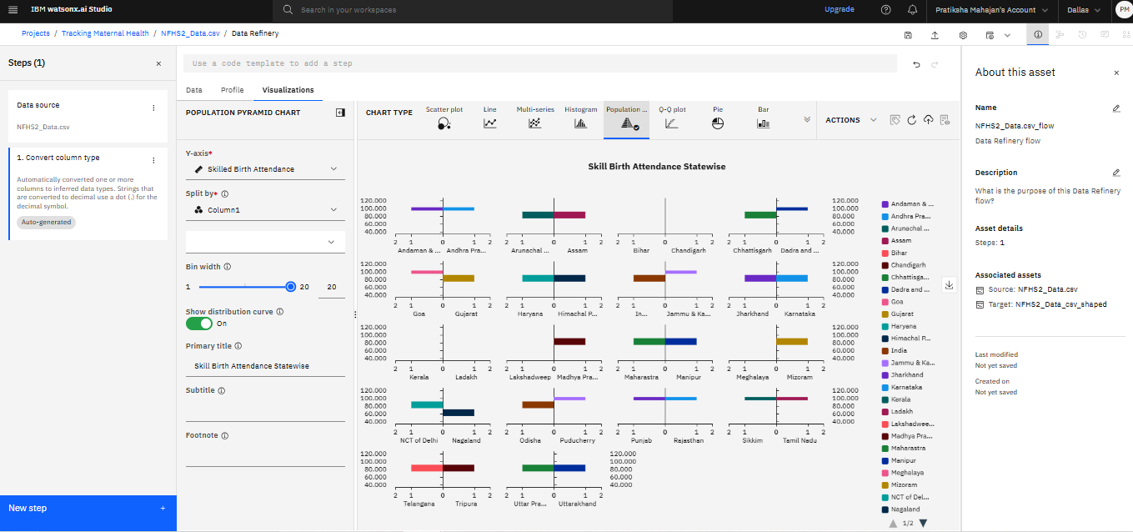
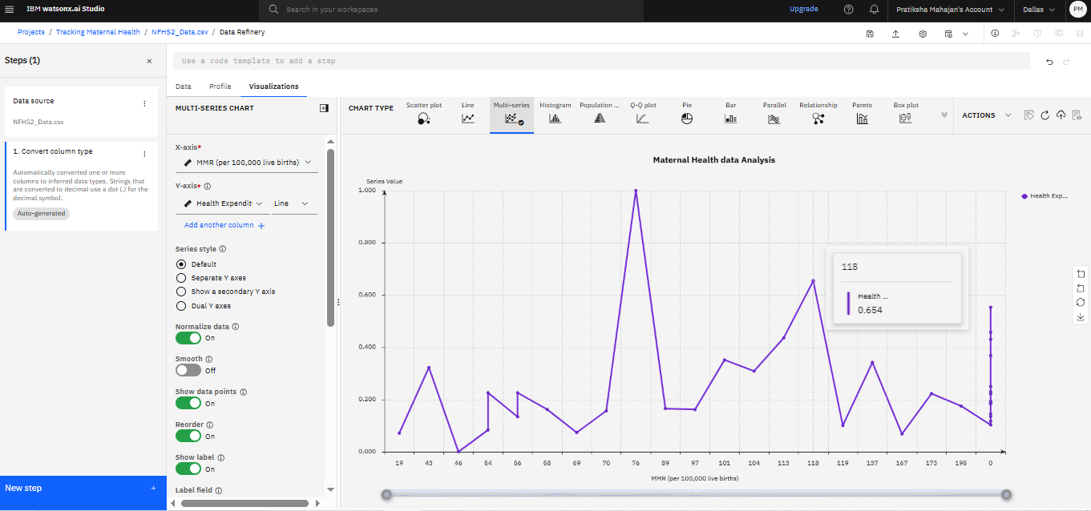

Slide 10
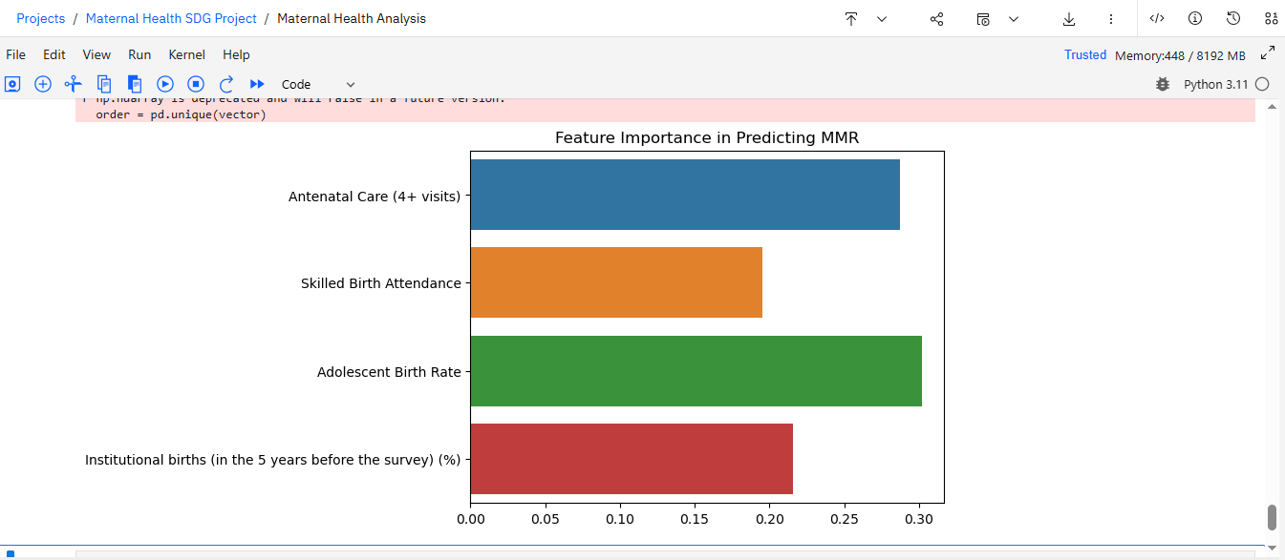
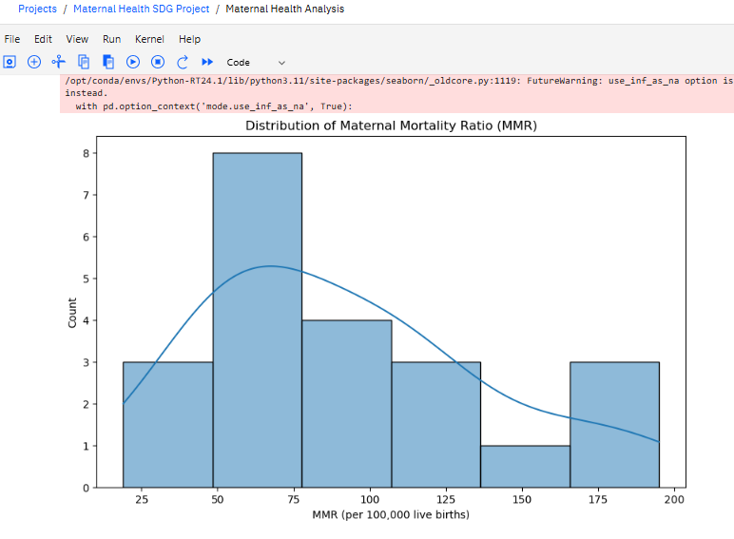

Slide 11
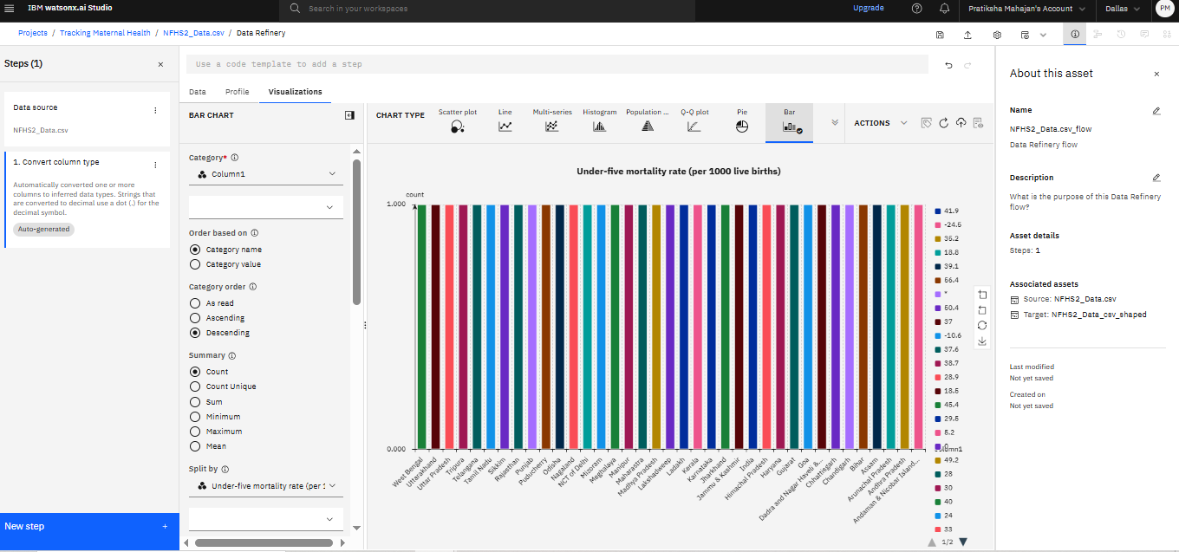
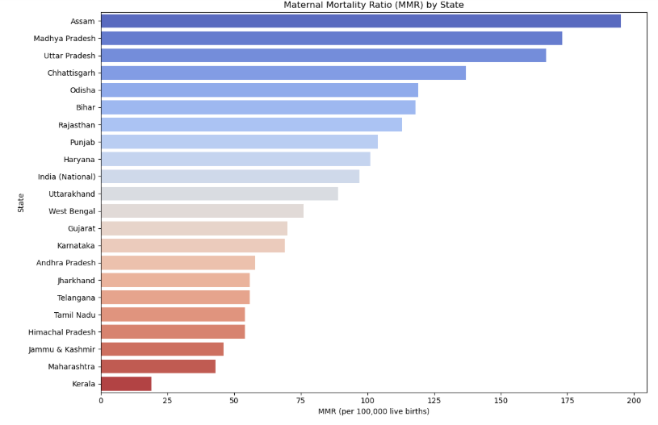

Slide 12
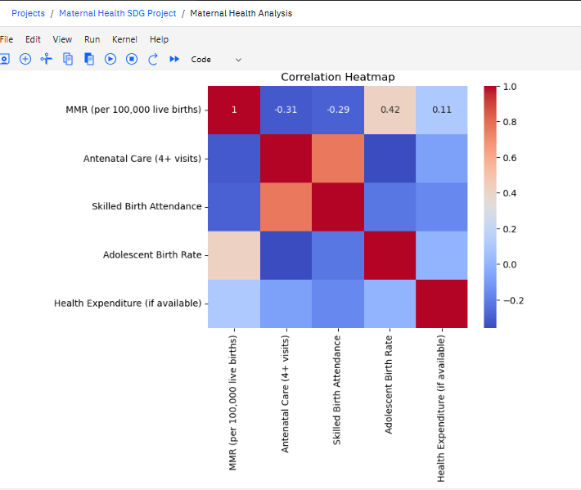
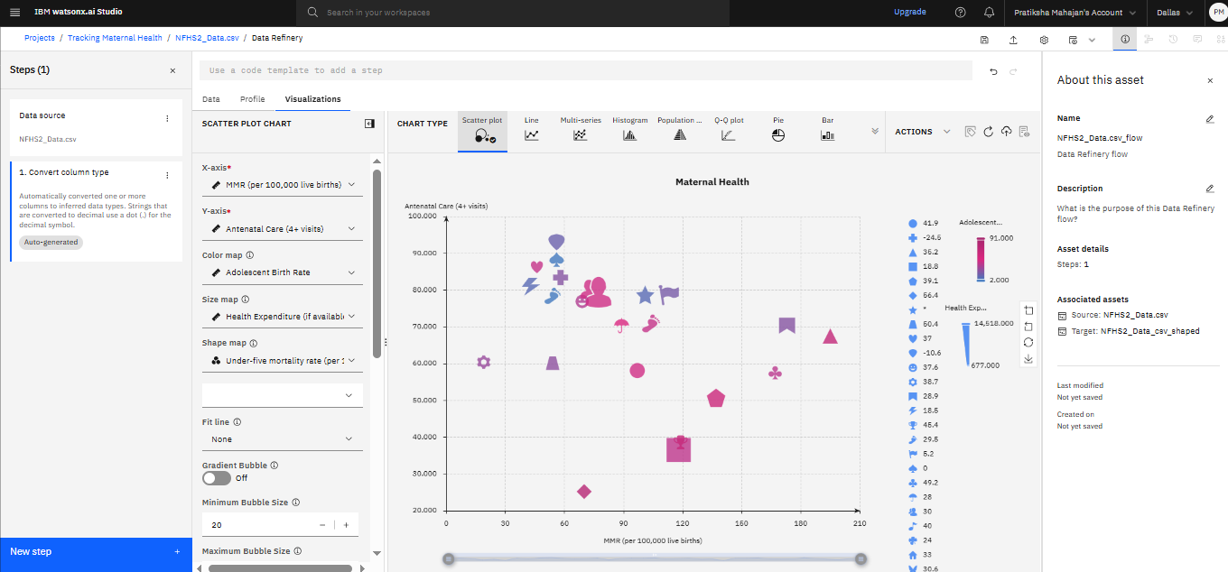

Slide 13
Conclusion
Maternal health outcomes improve with better antenatal coverage and education
ML models can help predict high-risk regions
System provides data-driven evidence to support policy makers and health planners
Challenge: Limited or inconsistent data from some regions

Slide 14
GitHub Link
https://github.com/Pratiksha-ux/maternal-health-SDG3.1/edit/main/README.md

Slide 15
Future Scope
Expand the system to global scale using WHO datasets
Add more ML models (e.g., Random Forest, XGBoost)
Deploy as a dashboard or app for local healthcare workers
Integrate with mobile platforms for real-time community-level input

Slide 16
References
AI Kosh Dataset – SDG Indicators
National Family Health Survey (NFHS)
( https://rchiips.org/NFHS/ )
Use: Data on maternal health, antenatal visits, skilled birth attendance, etc.
Ministry of Health and Family Welfare (MoHFW), Government of India (https://www.mohfw.gov.in/)
Use: National health mission policies, SDG 3.1 progress data

Slide 17

IBM Certifications

Slide 18

IBM Certifications

Slide 19

IBM Certifications

Slide 20
THANK YOU

